Slide 1
A 2d labile aether arising
out of
homogenization
Gilles Francfort ( Université Paris-Nord) joint work with Marc Briane (INSA Rennes) to appear in Comm. Math Phys.
Will explicit title at end of talk
linear 2nd order elliptic eqn. in 2d
periodic hom. - no fancy stochastics
Dirichlet b.c.’s
B a l t i m o r e J . M . M . — J a n u a r y 2 0 1 9

Slide 2
1/10
Linear Elasticity primer
displacement field
gradient of u a 2x2 matrix
constitutive relations (Hooke’s law)
symmetries
isotropic
equilibrium
scalar-valued case
vector-valued case
coercivity of Dirichlet form
ellipticity
strong ellipticity
usual assumption: very strong ellipticity
Korn
coercivity

Slide 3
2/10
Periodic classics
unit square cell
Homogenization (G or H conv.)
(Duvaut 70’s?)
isotropic case:
Homogenization + same formula +
(F. Proc. Royal Soc. Ed. 92)
?
isotropic case:
Gårding: if
is continuous,
Useless!

Slide 4
3/10
The Gamma-convergence viewpoint
?
Proof: Take
. Set, thanks to H-convergence,
Then,
Case H¹: OK if
(same proof with cut-off). Else?

Slide 5
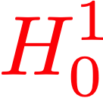
Onward

Slide 6
4/10
The Gamma-convergence viewpoint 2
Braides-Briane15
with
Cor: Geymonat-Muller-Triantafyllidis ARMA93

Slide 7
Onward: 2 isotropic phases
v.s.e.
s.e.

Slide 8
5/10
The Gutiérrez confusion factor
N=2
(Guttiérez J. Elasticity99)
v.f. 1/2
Prop:
mat. 1
v.f. 1/2
If sol. of the Dirichlet pb. with is bd. in H¹
mat. 2
then
e1
with
So what?
First, if
.
(Idea: Add a nul Lagrangian to make integrand pointwise nonnegative)
So, only interesting case:
Thm:
(Briane-F. 15)
In that case,
and

Slide 9
6/10
Gutiérrez 2
Consequence: since
unique periodic min. for homog. formula is a fct. of
Gutiérrez laminate cannot satisfy
Gutiérrez laminate is a bona fide example of loss of strict strong ellipticity
Generic case
Thm:
(Briane-F. M3AS15 + F.-Gloria CRAS16)
2
1
or
1
2
+ no loss of strict s.e.
Gutiérrez laminate is generically the only example of loss of strict strong ellipticity

Slide 10
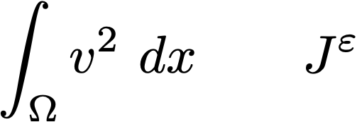
7/10
So what?
Gamma-convergence for
useless unless
bounds on almost min. can be had
However, even with
counterexample of Le Dret (Proc. Roy. Soc. Edin. A 87)
Idea!
Add
to
new
and look at Gamma-lim. of
in -weak topology

Slide 11
8/10
Weaker Gamma-limit
Thm:
(Briane-F. 19)
+ Gutierrez laminate. Then,
with
In that case
(proof uses heavily 2-scale conv. stochastic analogue)
At fixed coercivity of
unique minimizer to
Gamma-Convergence
Thm:
unique minimizer to
(unique because
strictly convex)

Slide 12
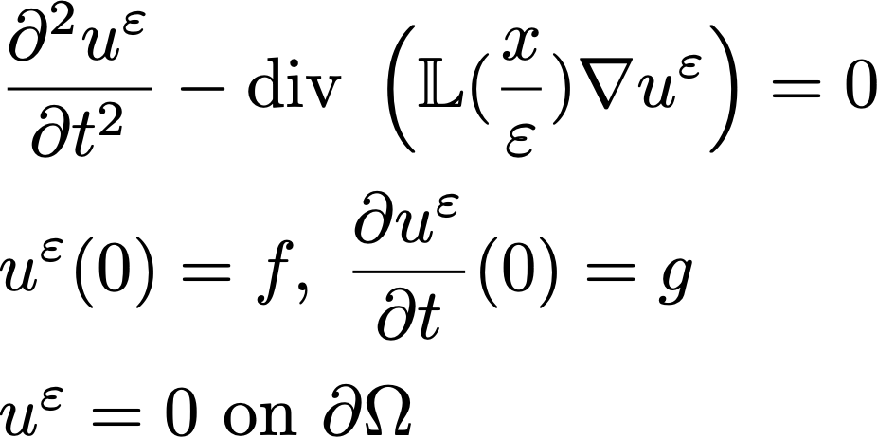
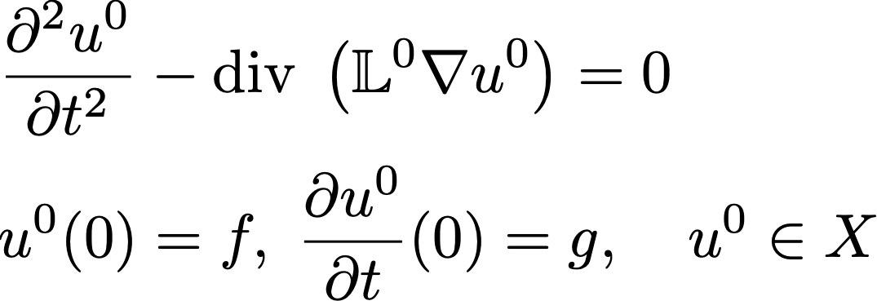
9/10
Elastodynamics
Consider
(We could add mass densities)
It has a unique solution. Idem for
(requires a proof), solution .
Laplace transform
Thm:
(Briane-F. 19)
unique solution to
(π,π)
Example:
is not a plane wave yet
is a plane wave oscillating in x1 and propagating in x2
(its second component has no b.c. on x1=0,π)
(0,π)

Slide 13
10/10
Aether
In its class (orthorombic) Gutierrez can be shown to be the only material that supports transverse waves
but not
longitudinal waves in direction 1
In the 1850’s, light~ transverse wave with 2 polarizations
(Cauchy, Maxwell, Green,…..)
requires solid
no longitudinal wave implies
3d!
rigid so that wave speeds >>1
Aether
Gutierrez is an anisotropic 2d aether constructed through homogenization of polite materials

